Slide 1
PURCHASE ORDER APPLICATION

Slide 2
INTRODUCTION
Hi everyone, my name is Milind Pruthi. I am a final year student currently pursuing my BTech degree at S.R.M. Institute of Science and Technology(SRMIST).
This project is a part of my 6 month internship at NEC Corporation India.
The project focuses on building a purchase order application.

Slide 3
Technology Used
HTML, CSS and JavaScript have been used for the basic structure of the webpage.
Flask is used as the backend framework and MySQL have been utilized as the backend database.
IDE used – Visual Studio Code.
The program is run in Virtual Environment.
Please read the documentation for setting up the system.

Slide 4
Functionalities of the Web Page
Login Page.
Choosing whether to create a new Purchase Order or edit an existing Purchase Order.
New Purchase Order page.
Editing an existing Purchase Order page

Slide 5
Steps to use this Web Application
The user accesses the login page and with the right credentials logs into the system.
Once the user is logged in, the user decides whether to create a new purchase order or edit an existing one.

Slide 6
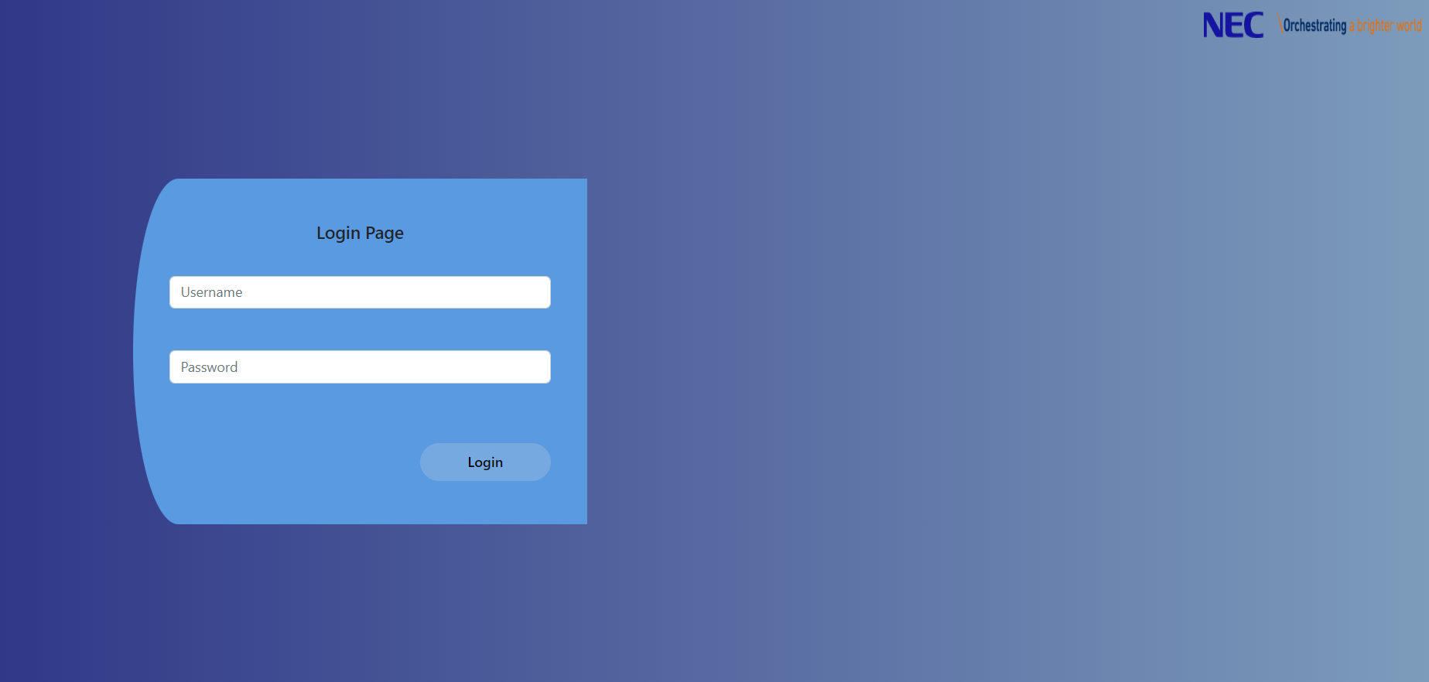
Login Page User Interface

Slide 7
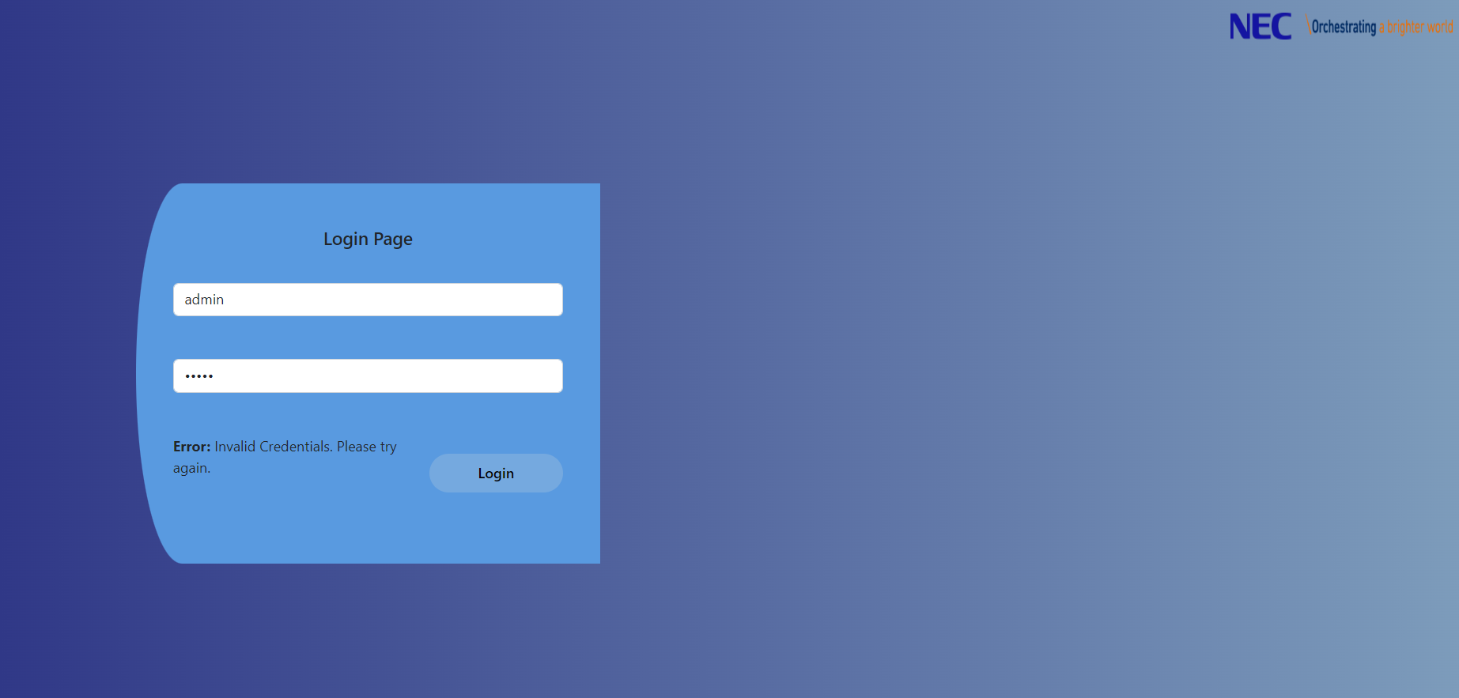
I have added in a check on login page for wrong credentials.

Slide 8
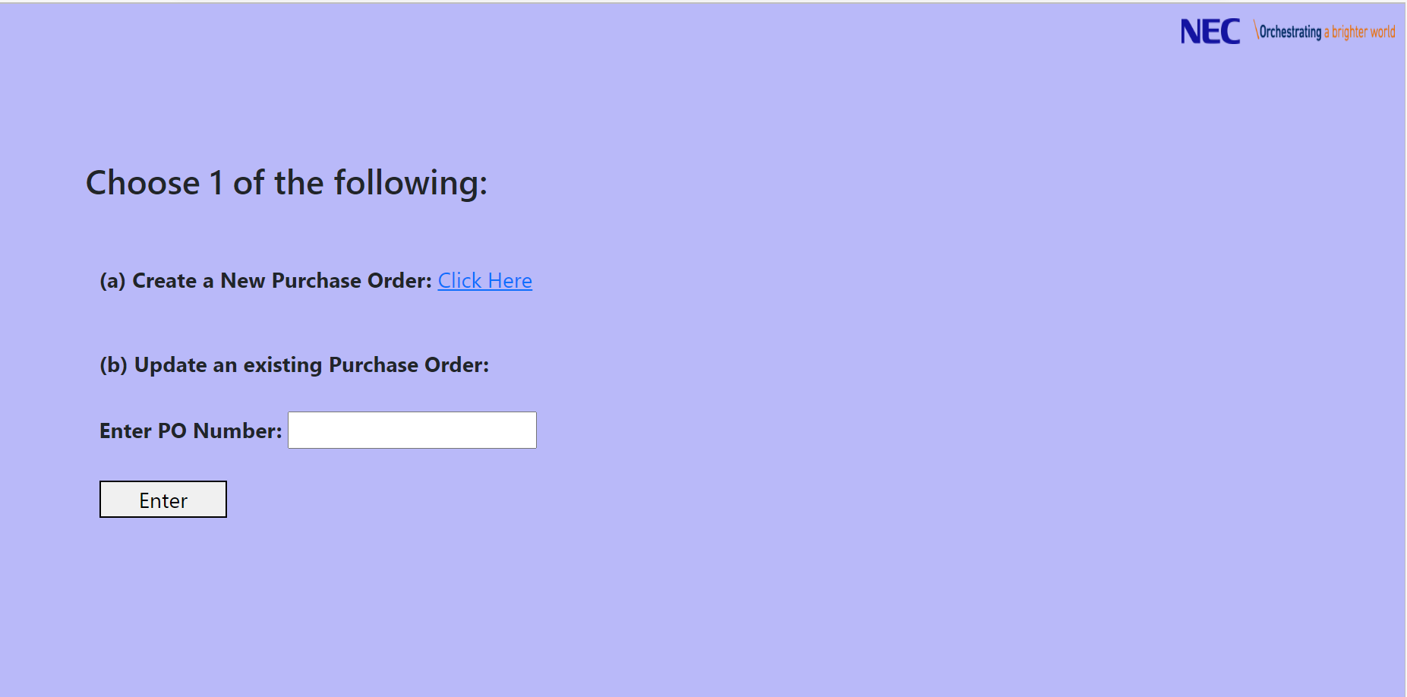
Create New Purchase Order or Edit an existing one

Slide 9
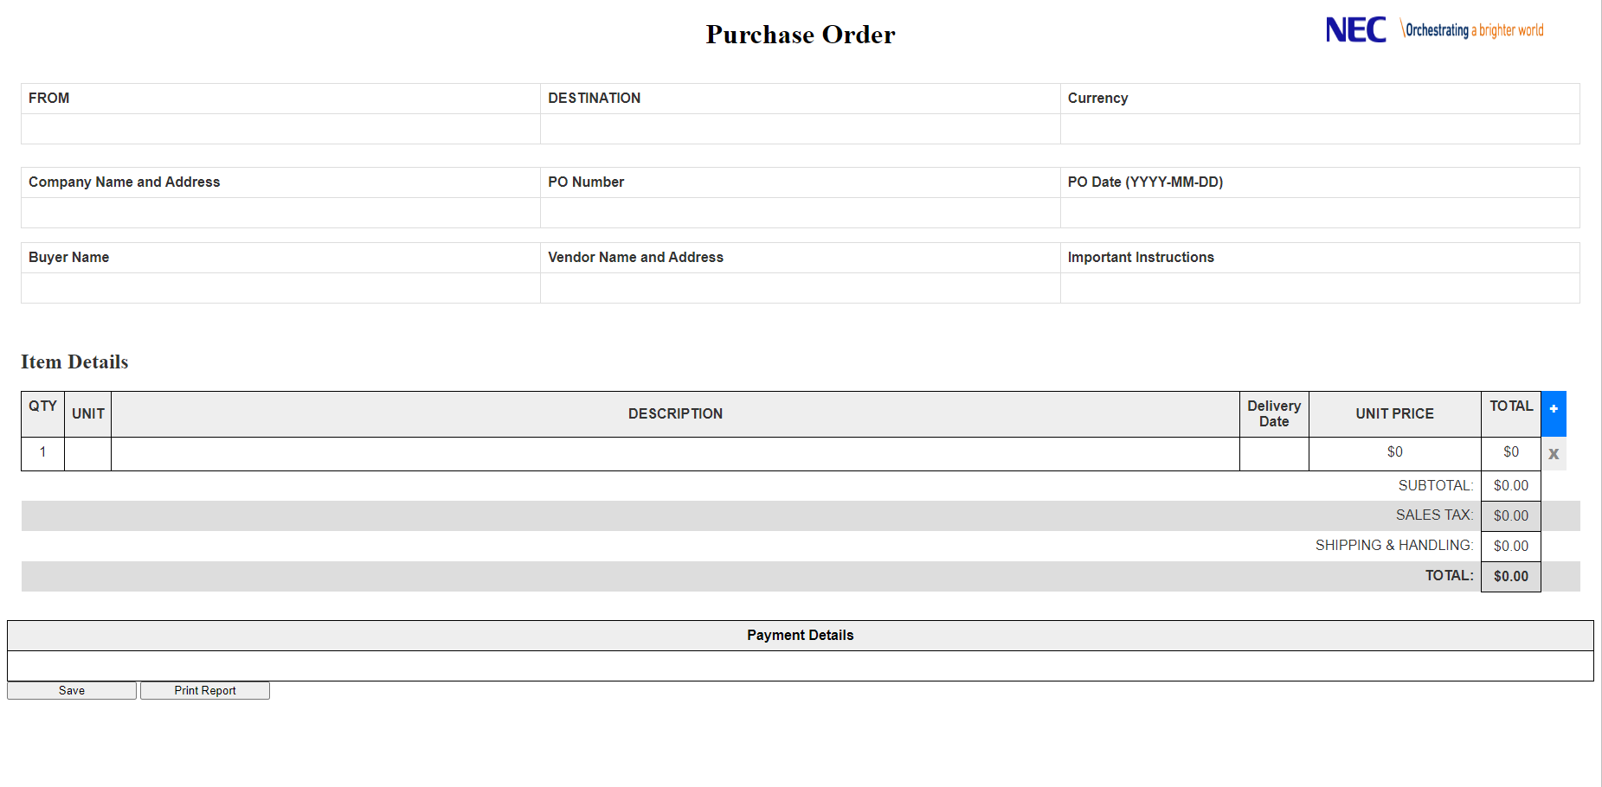
Create a new Purchase Order

Slide 10
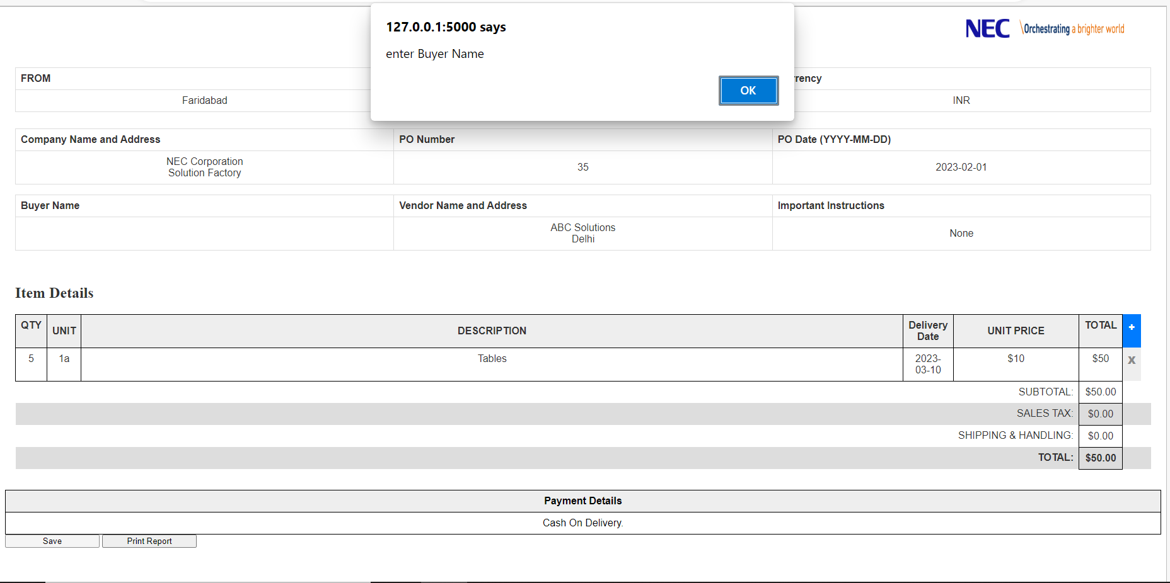
I have added in the necessary checks so that no entry is left empty.

Slide 11
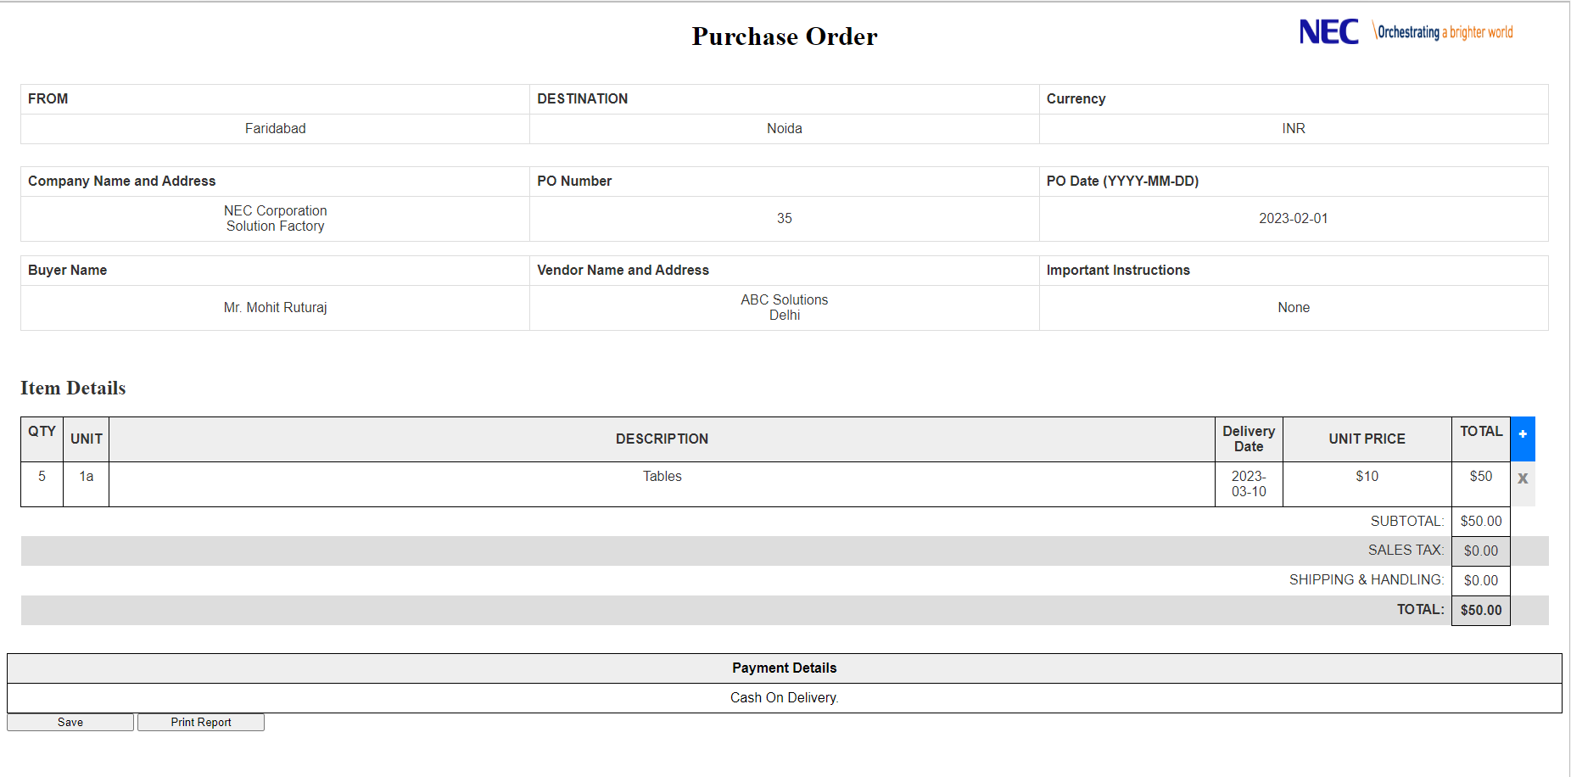
Once all the entries are filled in the user can click the save button at the bottom to insert the entries into the backend database.
Also the user can click the Print Report to save the Purchase Order details in the form of PDF.

Slide 12
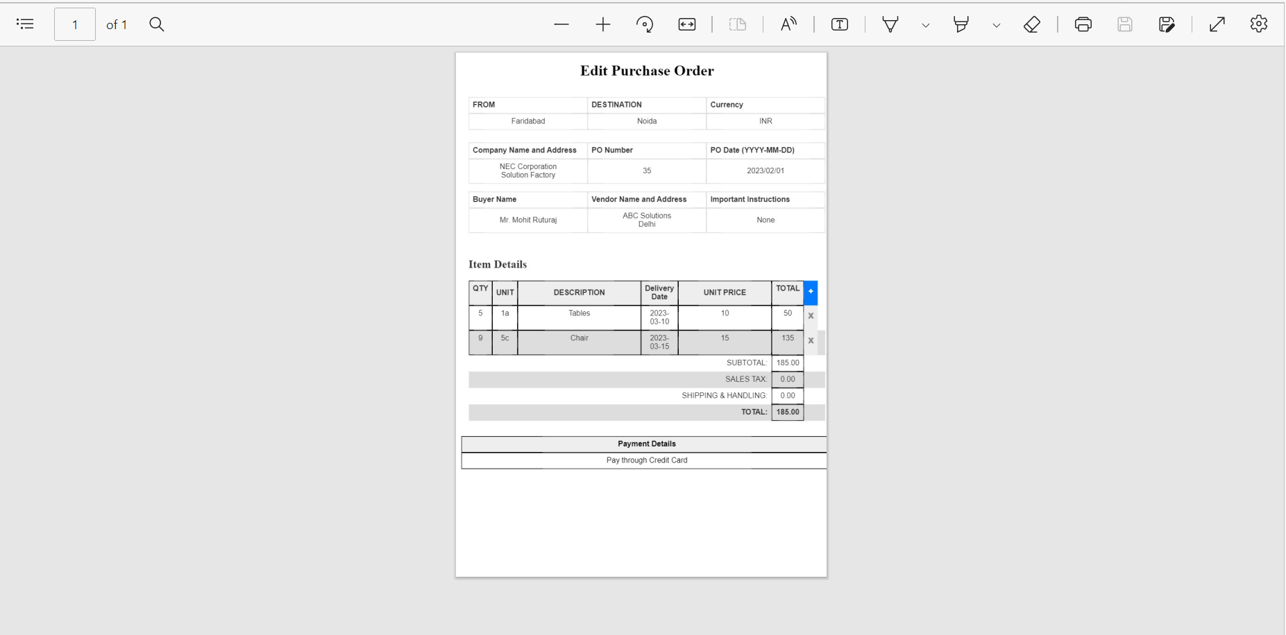
PDF Form of Purchase Order

Slide 13
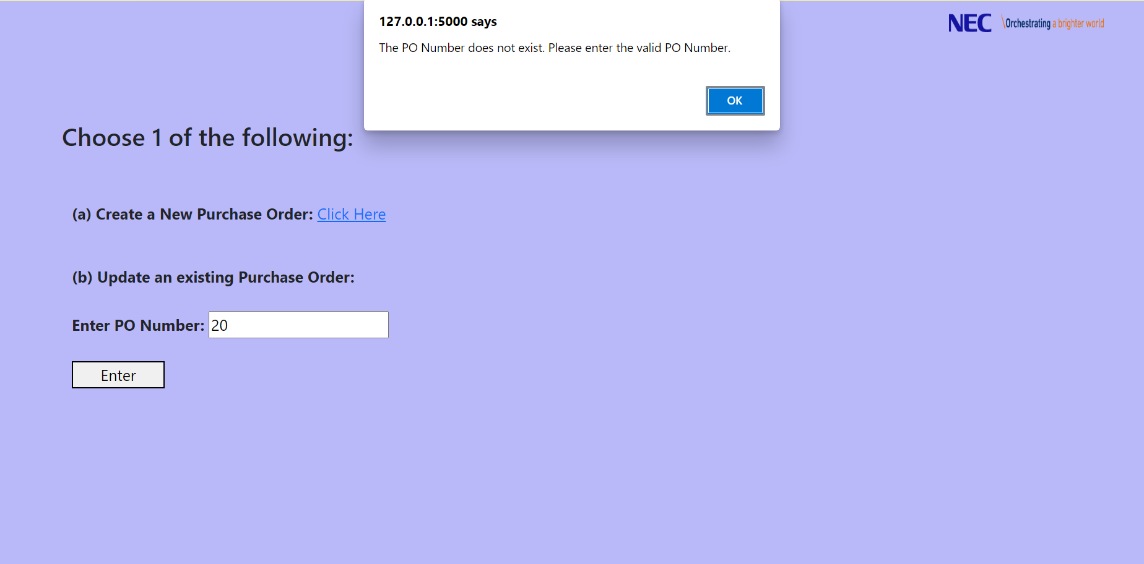
Edit an Existing Purchase Order
To edit an existing purchase order, the user needs to enter the purchase order number.
I have put in the alerts for entering invalid PO Numbers.

Slide 14
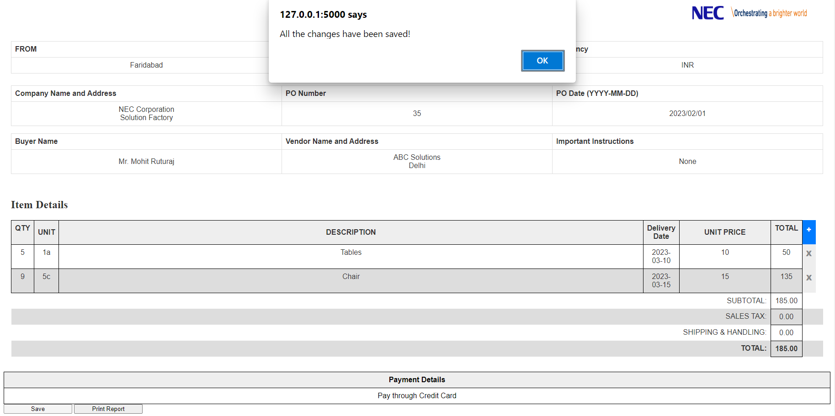
Once the user enters the correct PO Number, the user is redirected to the edit page.
Now the user can make the necessary changes and save those changes. Also this page does let the user change the PO Number since a PO Number shouldn’t change.
After making all the changes, user should then click on the save button to save the changes.

Slide 15
Summary
This concluded the complete website including the front-end and back-end framework. I hope that my work could meet the expectations and I could present the desired output.
I would like to conclude this presentation by saying that it was really nice experience working here at NEC. This was my second project under Ms. Shruti Shankar and I got to learn a lot about various things under her guidance. In this project I learned a lot of new things including jQuery. I got to learn how it is to work under a professional environment, the importance of deadlines and how to work consistently.

Slide 16
THANK YOU
By – Milind Pruthi
Mentor – Ms. Shruti Shankar

